Slide 1
Convolutional Neural Networks Advanced Topics Unit 5
Daniel Acuna
acuna.io

Slide 2
Contents
Small vs. large CNN
Structure of VGG16
Visualizing filters
CNN can be fooled
Implementing image classifer from scratch
Using VGG16

Slide 3
Classifying Handwritten Digits

Slide 4
A slightly more complex model
In the MNIST dataset, we only have 10 classes, and small input images
However, CNNs work great for more complex examples (bigger, more complex inputs; more classes)

Slide 5

"ImageNet" challenge
Part of the ILSVRC (ImageNet Large Scale Visual Recognition Challenge) competition
ImageNetcontains 1.2 million images, each manually labeled with one of 1,000 labels

Slide 6
VGG16
Winning entry for ImageNet 2014 (ILSVRC2014)
VGG16 broke records for accuracy
It contains 16 "computional layes"
The architecture introduced padding and max-pooling before they were common and widely available
We will explain structure in 6 groups of layers

Slide 7
VGG16

Slide 8
VGG16 (2)

Slide 9
VGG16 (3)

Slide 10
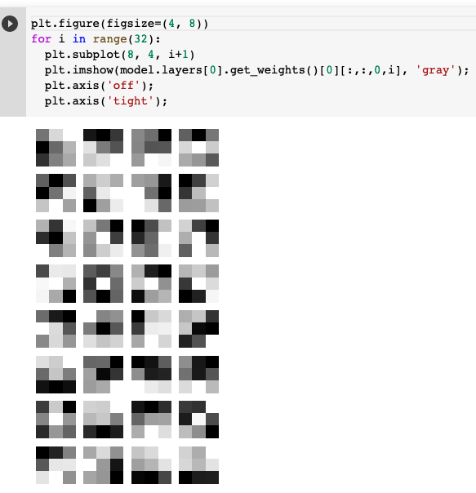
Advanced visualization of filters
Last class, we saw that we can visualize filters, but more in-depth filters are harder to visualize

Slide 11
Advanced visualization of filters (2)
To visualize filters in a more advance fashion, we can try to create images that most trigger a filter.

Slide 12
Advanced visualization of filters (3)
We are looking for the input image that maximizes the total activation of a filter

Slide 13
Advanced visualization of filters (3)
We can do this by gradient ascent but we freeze all of VGG16 and take the inputs as variables

Slide 14
Let's do it
https://colab.research.google.com/github/daniel-acuna/applied_deep_learning/blob/master/CNN/Chapter17_CNNs_3_Filter_Viz_1.ipynb

Slide 15
Visualization filters (2)

Slide 16
Visualization filters (3)

Slide 17
Visualization filters (3)

Slide 18
Visualization filters (4)

Slide 19
Advanced visualization part 2
Make predictions for a given image, ignore outcome, and look at CNN response

Slide 20
Visualizing filters, part 2

Slide 21
Visualizing filters, part 2 (2)

Slide 22
Visualizing filters, part 2 (3)

Slide 23
Visualizing filters, part 2 (3)

Slide 24
Adversarial attack

Slide 25
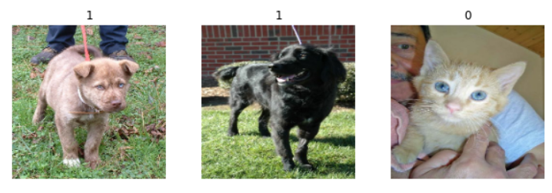
Image classification from
Image classification from scratch
This example shows how to do image classification from scratch, starting from JPEG image files on disk, without leveraging pre-trained weights or a pre-made Keras Application model.
We demonstrate the workflow on the Kaggle Cats vs Dogs binary classification dataset.

Slide 26
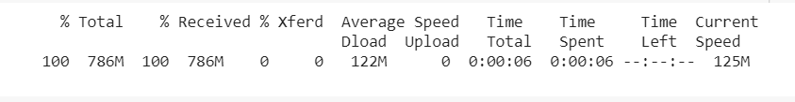
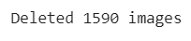
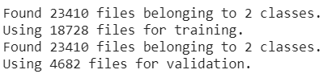
Image classification from scratch
Follow Steps in Notebook
Setup
Load the data: the Cats vs Dogs dataset
Raw data download. First, let's download the 786M ZIP archive of the raw data:
Filter out corrupted images
When working with lots of real-world image data, corrupted images are a common occurrence. Let's filter out badly-encoded images that do not feature the string "JFIF" in their header.
Generate a Dataset
Run code to generate data set

Slide 27
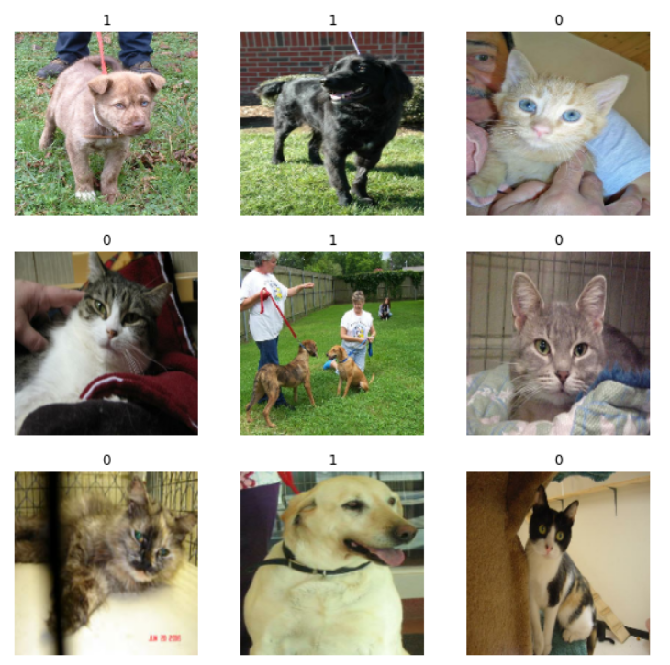
Image classification from scratch
Follow Steps in Notebook
Visualize the data
Here are the first 9 images in the training dataset. As you can see, label 1 is "dog" and label 0 is "cat".

Slide 28
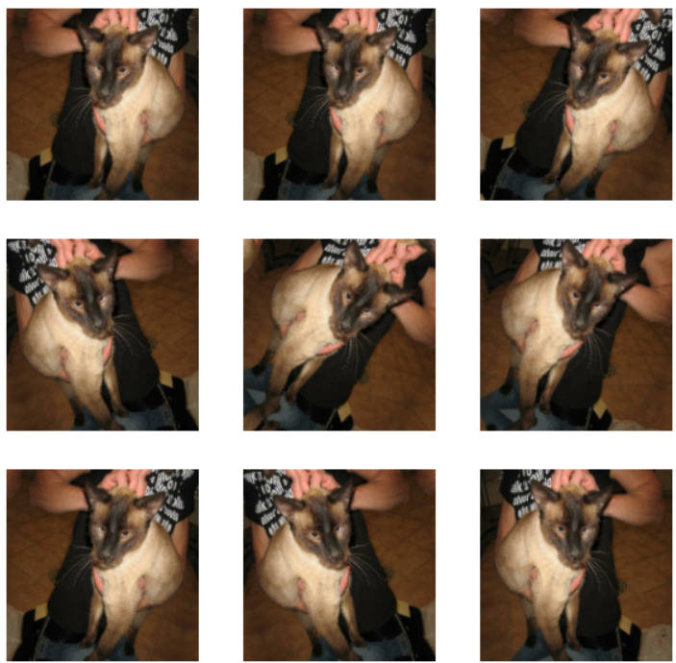
Image classification from scratch
Follow Steps in Notebook
Using image data augmentation
When you don't have a large image dataset, it's a good practice to artificially introduce sample diversity by applying random yet realistic transformations to the training images, such as random horizontal flipping or small random rotations.

Slide 29
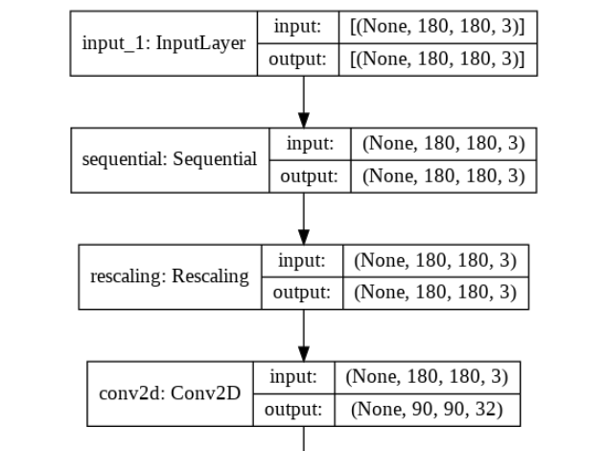
Image classification from scratch
Follow Steps in Notebook
Configure the dataset for performance
Let's make sure to use buffered prefetching so we can yield data from disk without having I/O becoming blocking:
Build a model
We'll build a small version of the Xception network.

Slide 30

Image classification from scratch
Follow Steps in Notebook
Train the model
Run inference on new data
Note that data augmentation and dropout are inactive at inference time.
To Get Started
Go to this URL
https://keras.io/examples/vision/image_classification_from_scratch/
Click Google Colab (remember to use GPU; change epochs to 10)

